Slide 1




Introduction to Kubernetes
Jinhong Brejnholt
Saxo Bank
And a bit more…
jbrejnholt

Slide 2
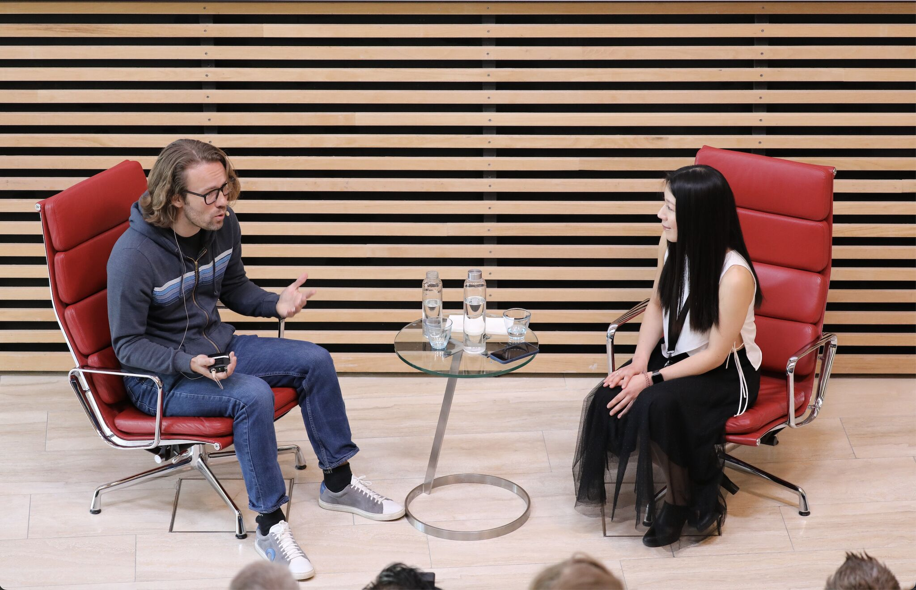
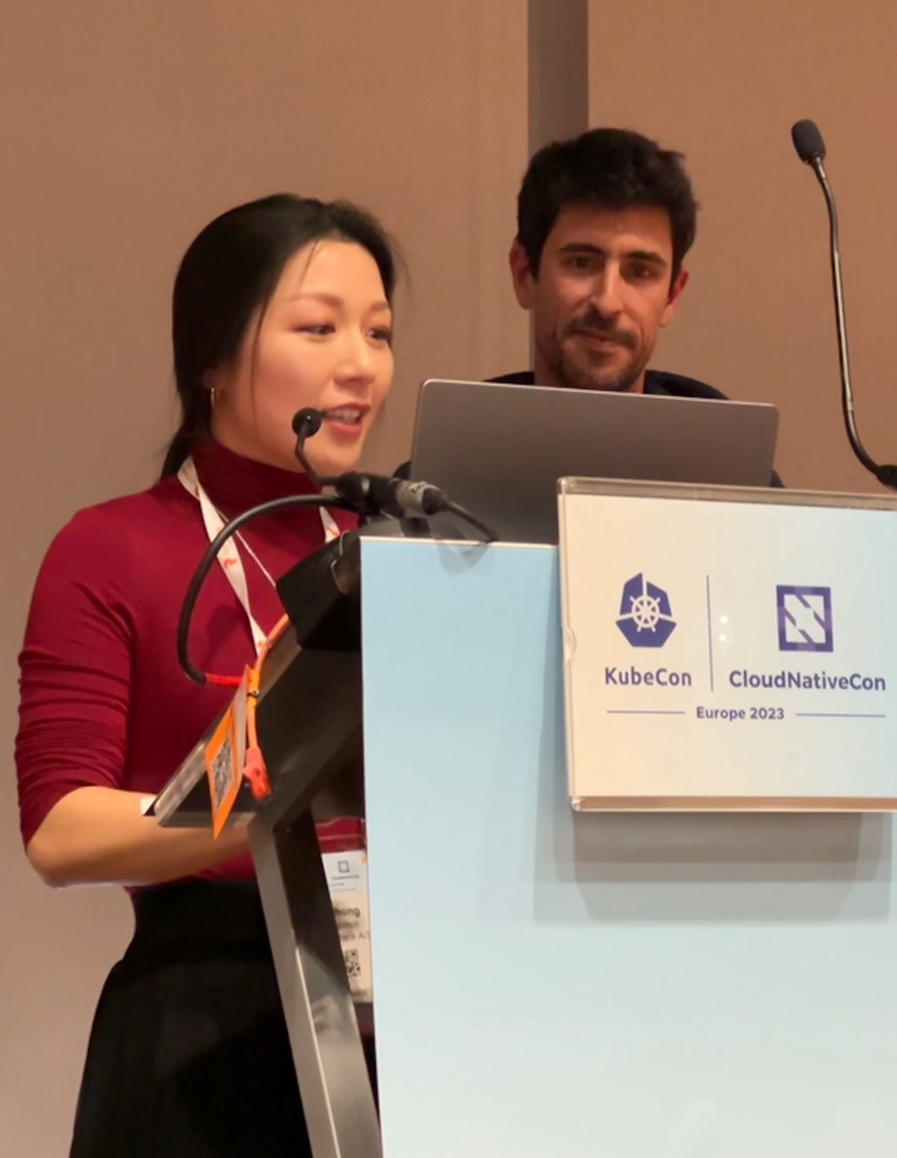
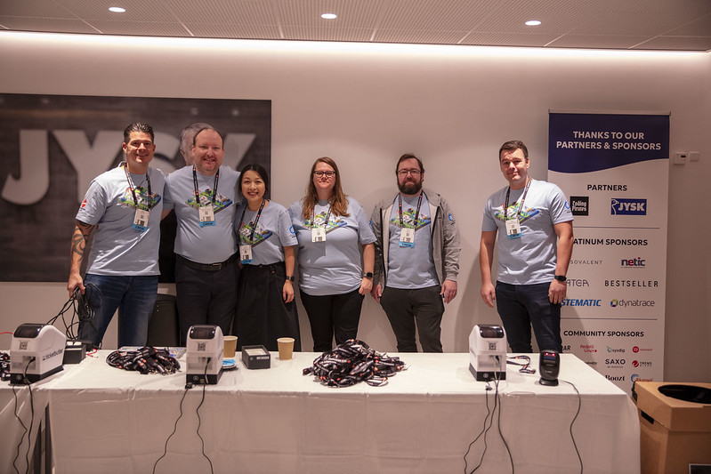
Cloud Native Community
Tuesday, February 2, 20XX
jbrejnholt

Slide 3
Agenda
Kubernetes
Platform Engineering
jbrejnholt

Slide 4

8012 Companies

Slide 5
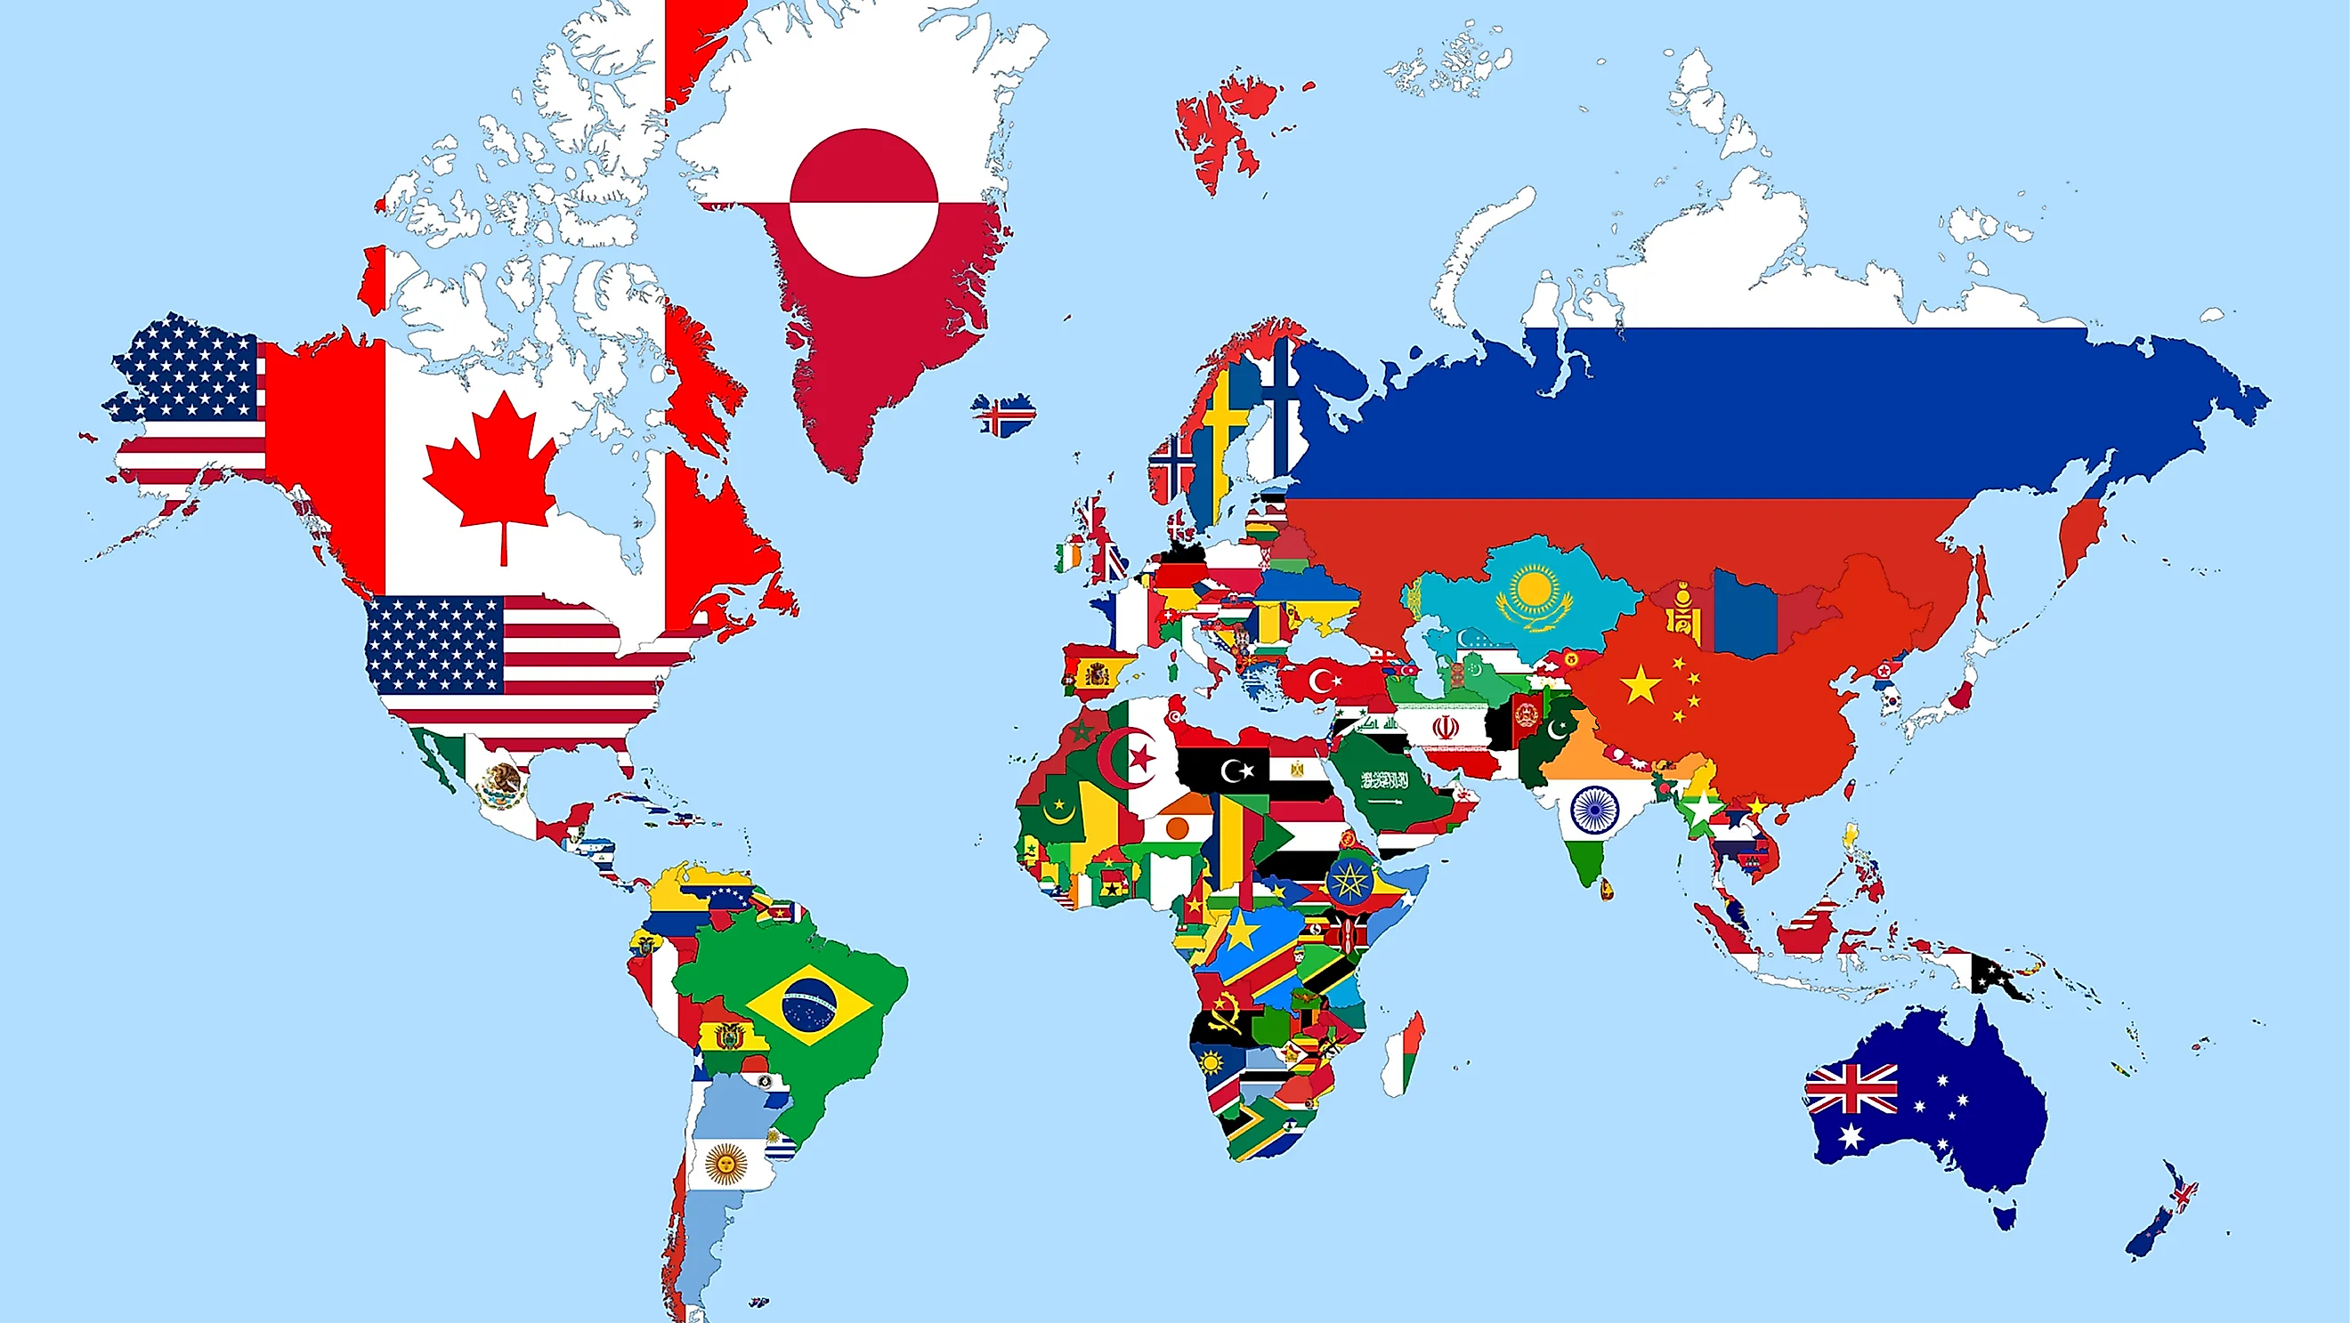
44 Countries

Slide 6

77115 Contributors

Slide 7
jbrejnholt

Slide 8


Background
Greek for “Helmsman”; root of the word “Governor”
Container orchestrator
Supports multiple cloud and bare-metal
Inspired and informed by Google’s experiences and internal systems
Open source, written in Go
Kubernetes.io
Kube or K8s
jbrejnholt
Notes:
Open-source software (OSS) is computer software that is released under a license in which the copyright holder grants users the rights to use, study, change, and distribute the software and its source code to anyone and for any purpose.^{[1][2]}
Open-source software may be developed in a collaborative, public manner.

Slide 9

jbrejnholt

Slide 10



jbrejnholt
Notes:
It starts with a server

Slide 11
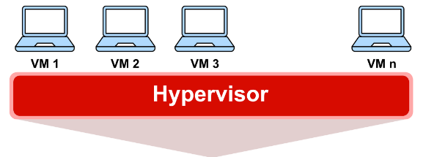
License
Slow startup
RAM/CPU
Disk space
jbrejnholt

Slide 12

jbrejnholt

Slide 13

Portable
Fast
Less RAM/CPU
Depends on OS
Small
Packaged as OS
jbrejnholt

Slide 14
jbrejnholt

Slide 15

Kubernetes to the rescue
jbrejnholt

Slide 16
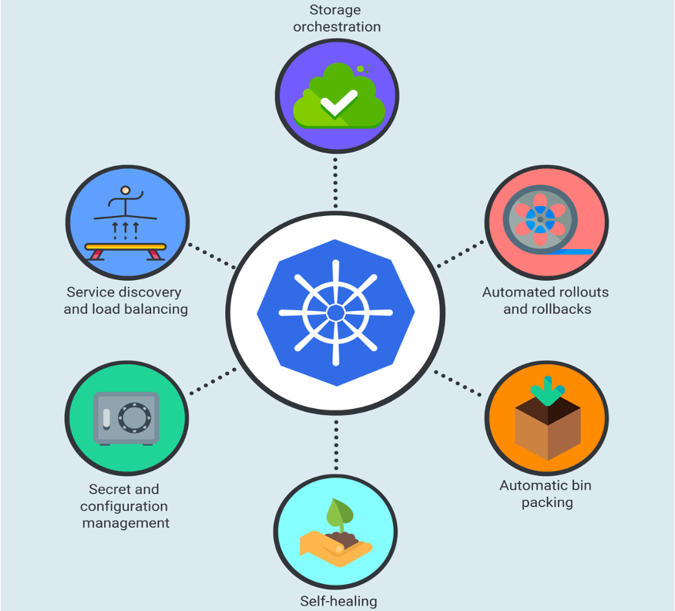
Feature Set
jbrejnholt

Slide 17












Concepts
jbrejnholt

Slide 18
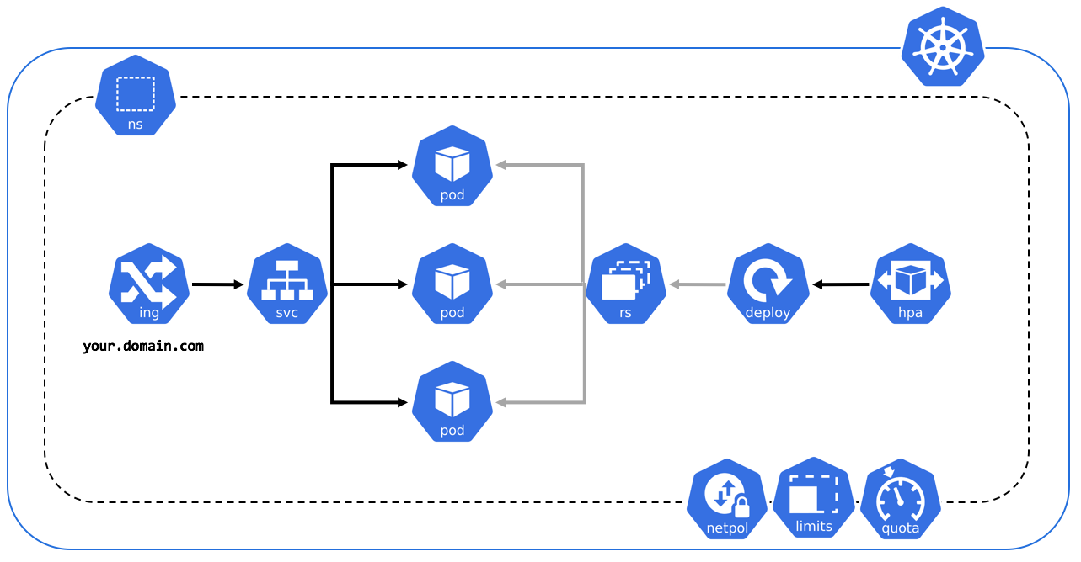
Concepts
jbrejnholt

Slide 19
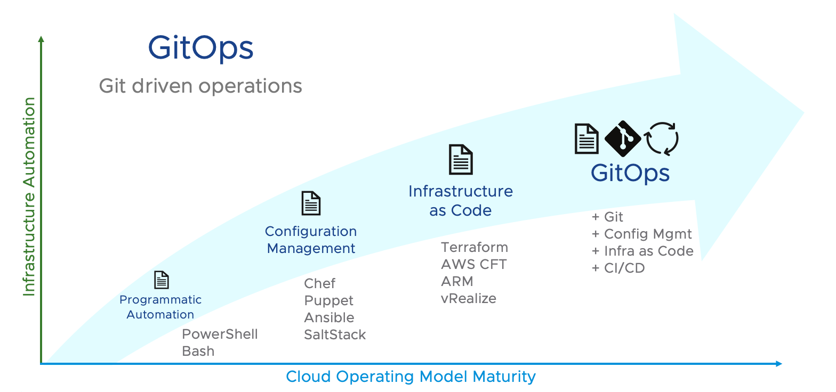
Deployment
jbrejnholt

Slide 20
Beyond Kubernetes
There is much more than deploying Kubernetes clusters
jbrejnholt

Slide 21


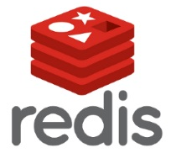



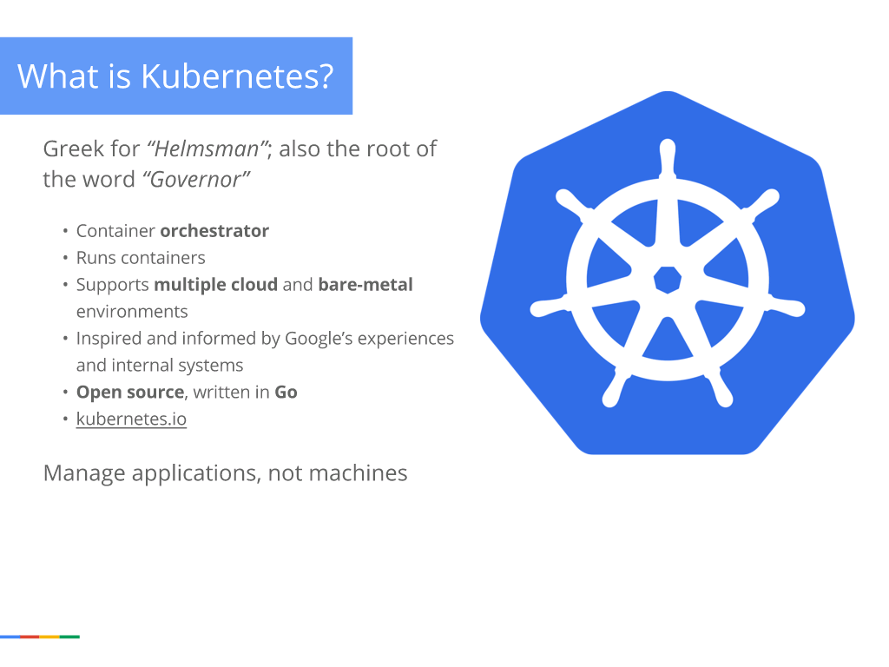











Capabilities

Slide 22

jbrejnholt

Slide 23
Platform Engineering
The discipline of designing and building toolchains and workflows that enable self-service capabilities for software engineering organizations in the cloud-native era.
Platform engineers provide an integrated product most often referred to as an “Internal Developer Platform” covering the operational necessities of the entire lifecycle of an application.
jbrejnholt

Slide 24
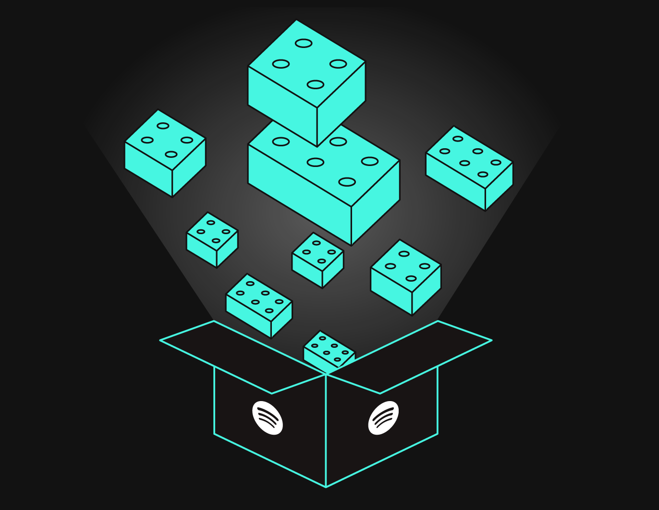
Templating
jbrejnholt

Slide 25

jbrejnholt

Slide 26
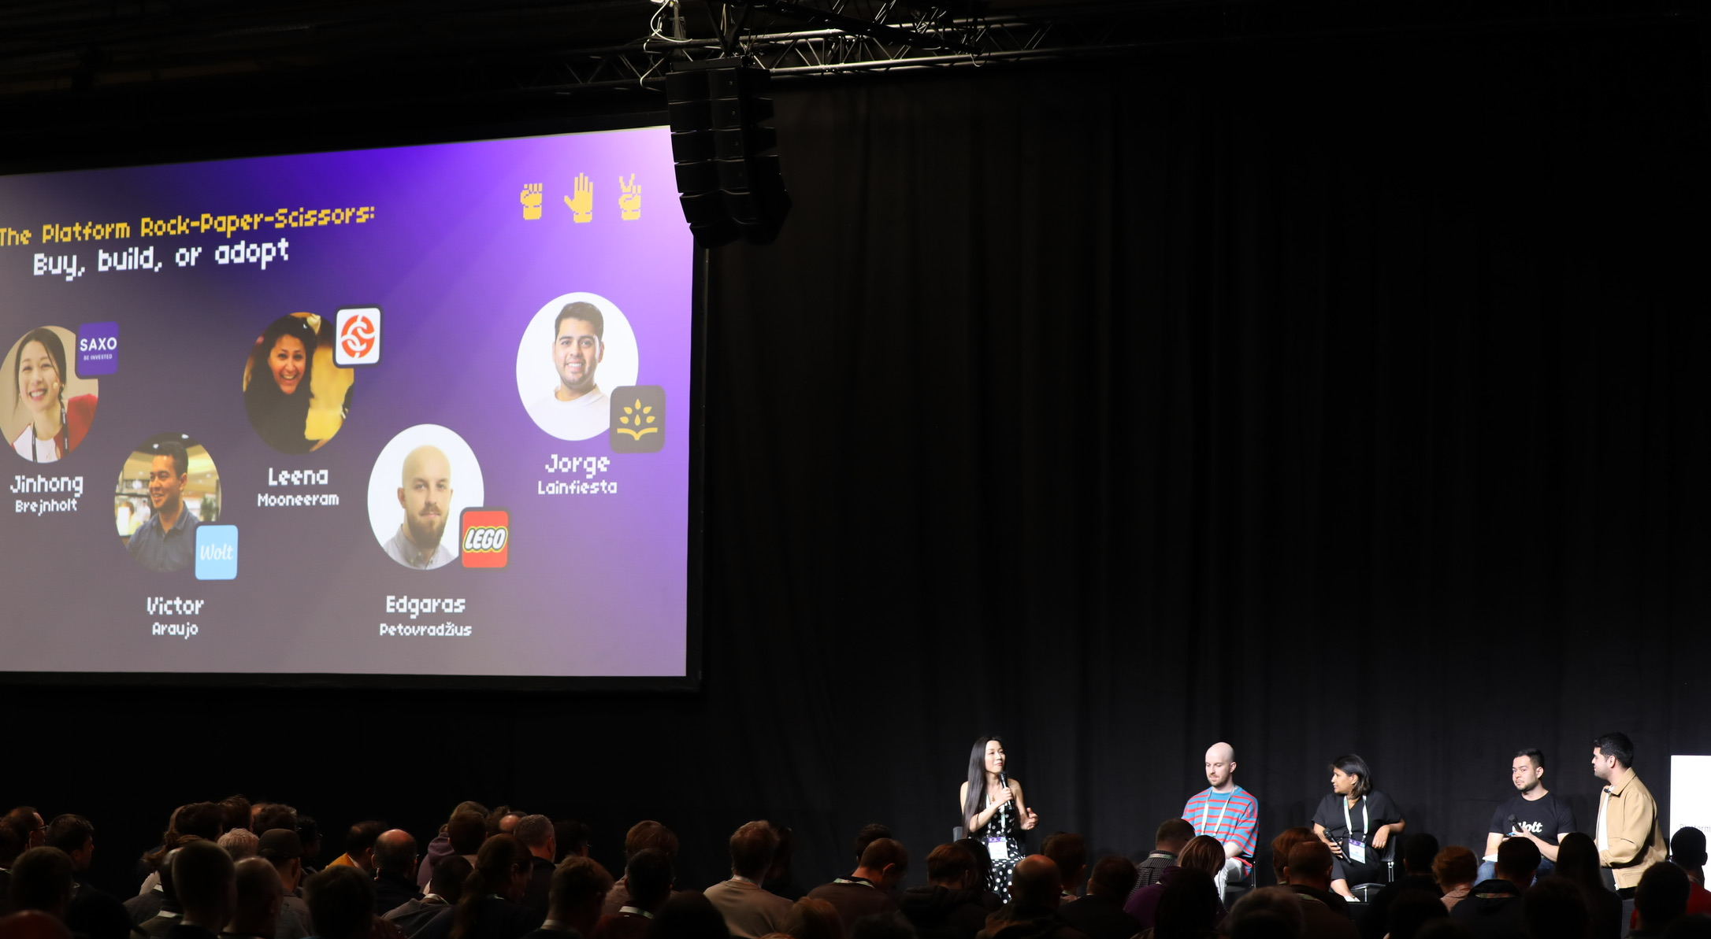
Buy, Build or Adopt
Panel: The Platform Rock-Paper-Scissors: Build, Adopt, Buy

Slide 27
Q & A
jbrejnholt

